Slide 1
Machine Leaning

Slide 2
Machine Learning Challenges
Data comes in all shapes and sizes.
Preprocessing your data might require specialized knowledge and tools.
It takes time to find the best model to fit the data.

Slide 3
Questions to Consider Before You Start
Every machine learning workflow begins with three questions:
What kind of data are you working with?
What insights do you want to get from it?
How and where will those insights be applied?
Your answers to these questions help you decide whether to use supervised or unsupervised learning.

Slide 4
Choose supervised learning if you need to train a model to make a prediction--for example, the future value of a continuous variable, such as temperature or a stock price, or a classification—for example, identify makes of cars from webcam video footage.
Choose unsupervised learning if you need to explore your data and want to train a model to find a good internal representation, such as splitting data up into clusters.

Slide 5
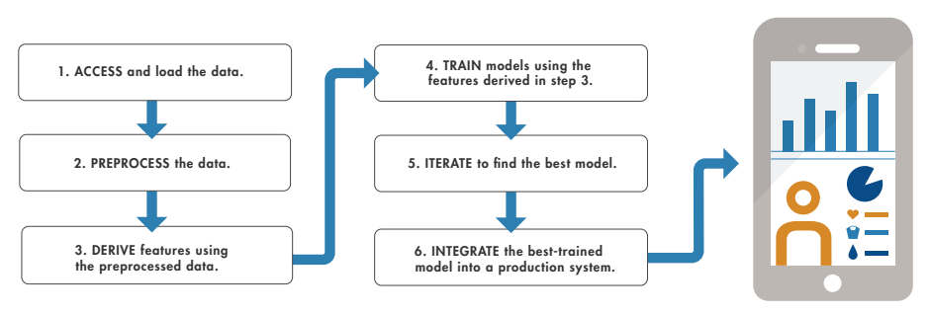
Workflow at a Glance

Slide 6
Training a Model to Classify Physical Activities
This example is based on a cell phone health-monitoring app.
The input consists of three-axial sensor data from the phone’s accelerometer and gyroscope.
The responses, (or output), are the activities performed–walking, standing, running, climbing stairs, or lying down.
We want to use the input data to train a classification model to identify these activities.
Since our goal is classification, we’ll be applying supervised learning.
The trained model (or classifier) will be integrated into an app to help users track their activity levels throughout the day.

Slide 7
Step One: Load the Data
To load data from the accelerometer and gyroscope we do the following:
1. Sit down holding the phone, log data from the phone, and store it in a text file labeled “Sitting.”
2. Stand up holding the phone, log data from the phone, and store it in a second text file labeled “Standing.”
3. Repeat the steps until we have data for each activity we want to classify.
We store the labeled data sets in a text file. A flat file format such as text or CSV is easy to work with and makes it straightforward to import data.

Slide 8
Step Two: Preprocess the Data
We import the data into MATLAB and plot each labeled set. To preprocess the data we do the following:
1. Look for outliers–data points that lie outside the rest of the data.
2. Check for missing values (perhaps we lost data because the connection dropped during recording).
3. Remove gravitational effects from the accelerometer data so that our algorithm will focus on the movement of the subject, not the movement of the phone. A simple highpass filter such as a biquad filter is commonly used for this.
4. Divide the data into two sets. We save part of the data for testing (the test set) and use the rest (the training set) to build models. This is referred to as holdout, and is a useful cross validation technique.

Slide 9
Step Three: Derive Features
Deriving features (also known as feature engineering or feature extraction) is one of the most important parts of machine learning.
It turns raw data into information that a machine learning algorithm can use.
For the activity tracker, we want to extract features that capture the frequency content of the accelerometer data.
These features will help the algorithm distinguish between walking (low frequency) and running (high frequency).
We create a new table that includes the selected features.

Slide 10
Step Four: Build and Train the Model
When building a model, it’s a good idea to start with something simple; it will be faster to run and easier to interpret.
We start with a basic decision tree.
We start with a K-nearest neighbors (KNN), a simple algorithm that stores all the training data, compares new points to the training data, and returns the most frequent class of the “K” nearest points.
That gives us 98% accuracy compared to 94.1% for the simple decision tree

Slide 11
Step Five: Improve the Model
Improving a model can take two different directions: make the model simpler or add complexity.
First, we look for opportunities to reduce the number of features.
If our model can’t differentiate dancing from running because it is over-generalizing, then we need find ways to make it more fine-tuned.

Slide 12
Thank You

